Slide 1
Web Site Development

Slide 2
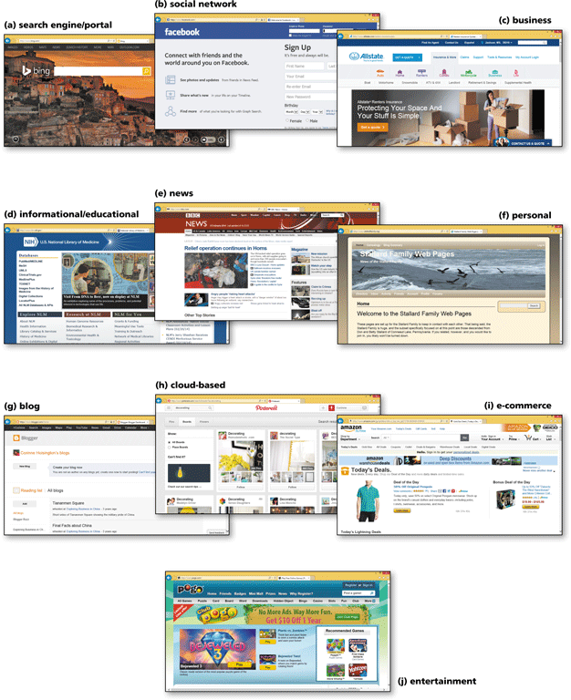
Type of Websites
Portal
Search Engine
Social Network
Facebook
LinkedIn
Twitter
Business
e-commerce
Informational/Educational
blog
edu
Personal

Slide 3
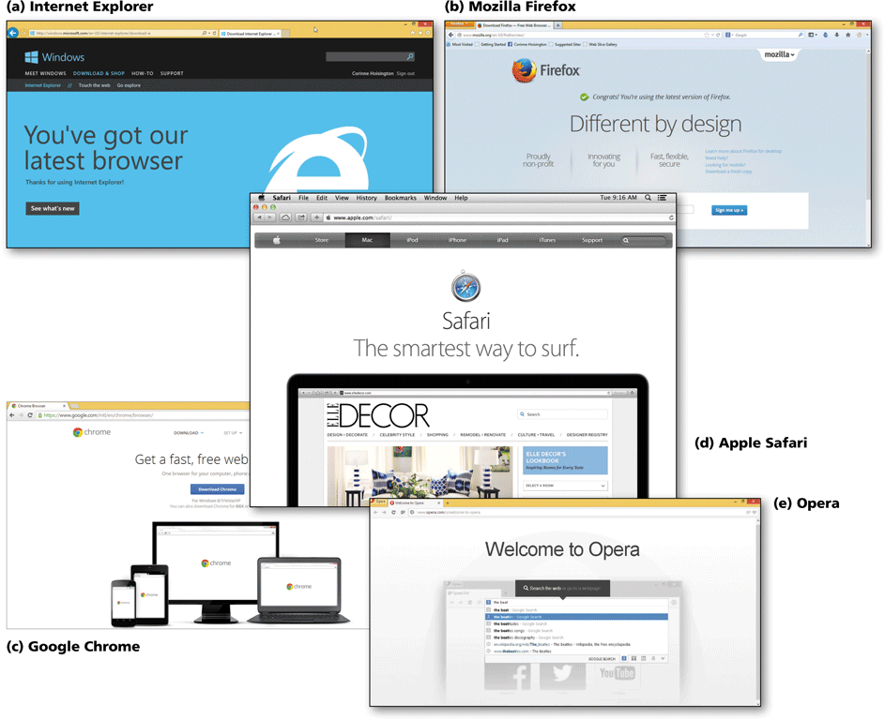
Browse Consideration
Internet Explorer
Mozilla Firefox
Google Chrome
Safari
Opera

Slide 4
Web Features
URL → Uniform Resource Locator
HTTP → Hypertext Transfer Protocol
Website Hosting
Domain Name
IP Address
Server Space
Web Programing Languages
HTML and XHTML
PHP / ASP / JQuery / JavaScript

Slide 5
WHAT IS HTML?
HTML (Hypertext Markup Language) is a language used to create documents on the web.
HTML is meant for meaning and structure of a web page’s content.
HTML contains tags that organize and structure text, include images, create forms & tables, and link to other documents or web pages all across the Internet.

Slide 6
HTML Syntax
The basic syntax of HTML is made up Tags, Attributes and Elements.
<html>
HTML tags usually come in pairs, like so:
<body> </body>
The first tag is called the opening tag and the second is called the closing tag.
<article> content here </article>
opening tag closing tag

Slide 7
HTML Syntax
Attributes
Attributes provide extra information about an element and save always specified in the opening tag.
<article attribute=“value”></attribute>
Quotation masks is more common, cleaner, and best practice.
Elements
An element is a tag and the content it wraps around, for example
<p> Hello MAC270</P>
tag element tab

Slide 8
HTML Parent / Child Structure
body
h1
H2
p
p
em
strong

Slide 9
Editors for Web Development
Notepad++
Sublime Text
Brackets
Adobe Dreamweaver

Slide 10
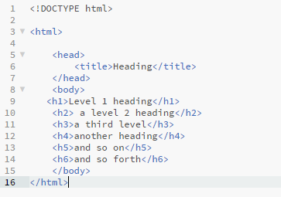
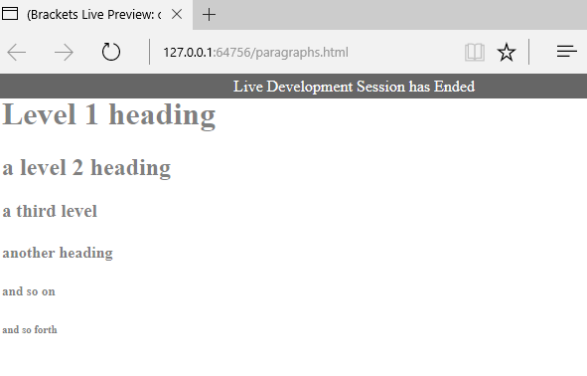
First Web Page

Slide 11
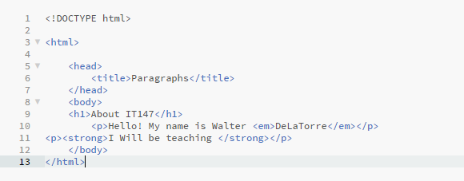
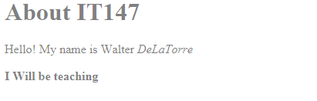
Element tags
MAC270
MAC270

Slide 12
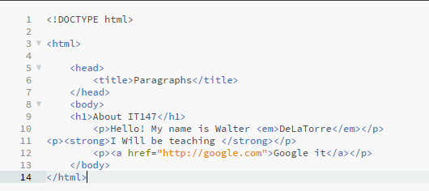
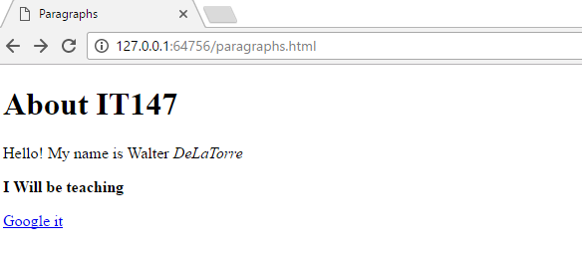
Links
MAC270
MAC270

Slide 13
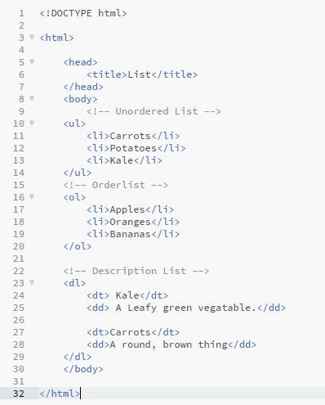
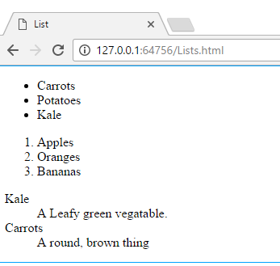
Lists

Slide 14
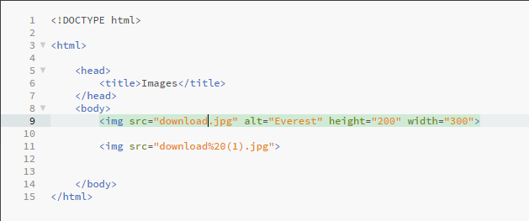
Images

Slide 15
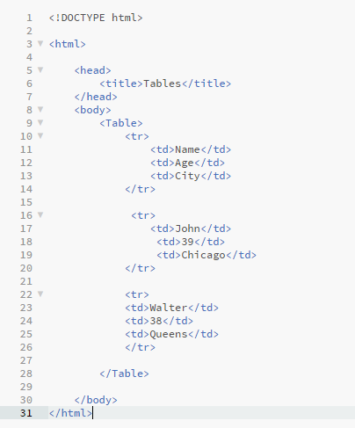
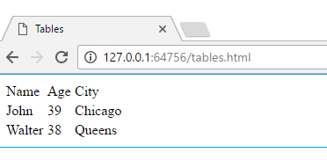
Tables

Slide 16
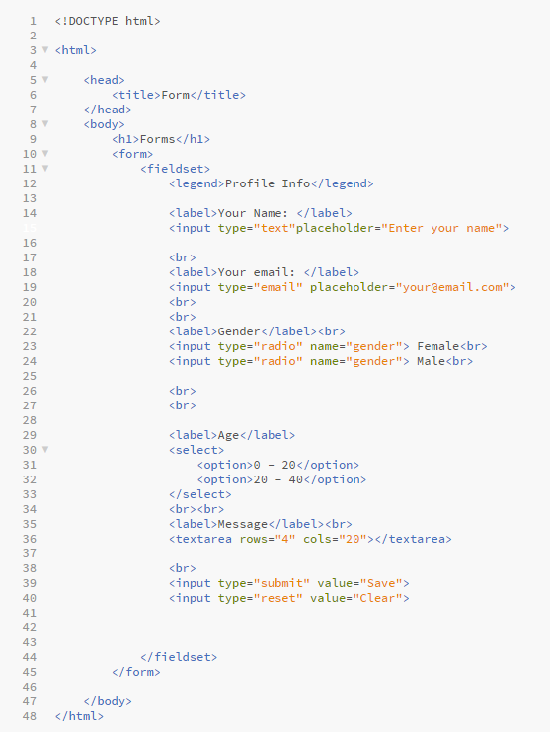
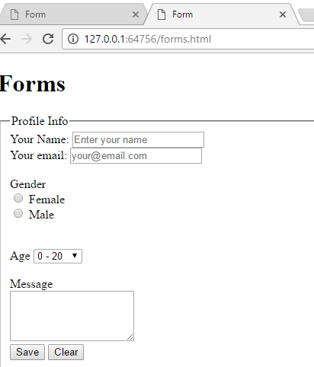
Forms

